Slide 1

Training a Neural Network with Backpropagation
Using pytorch and Tensorflow

Slide 2
What is PyTorch?
PyTorch is an open-source machine learning framework developed by Facebook’s AI Research lab.
It’s mainly used for:
Deep learning (neural networks for vision, NLP, speech, etc.)
Scientific computing (tensor operations like NumPy, but faster with GPUs).
It’s known for being easy to use, flexible, and Pythonic compared to some older frameworks

Slide 3
Core Concepts
1. Tensors
The building blocks in PyTorch.
Think of them like NumPy arrays, but they can run on GPUs for speed.
import torch
x = torch.tensor([[1, 2], [3, 4]]) # 2x2 tensor
print(x)
print(x.device) # Shows where it lives (CPU/GPU)

Slide 4
Core Concepts
2. Automatic Differentiation (autograd) )
PyTorch can automatically compute gradients (derivatives) for optimization.
This is what powers neural network training
x = torch.tensor(2.0, requires_grad=True)
y = x**2 + 3*x + 1
y.backward() # computes dy/dx
print(x.grad) # derivative = 2x + 3 → 7

Slide 5
Core Concepts
3. Neural Networks (torch.nn)
PyTorch has a module for building networks easily.
Every Neural network is buit by subclassing nn.Module
Layers are objects, and you connect them in nn.Module
_init to define layers
Forward to define data flows
Feedforward
import torch.nn as nn
class SimpleNN(nn.Module):
def __init__(self):
super(SimpleNN, self).__init__()
self.fc1 = nn.Linear(10, 5) # input 10 → output 5
self.fc2 = nn.Linear(5, 1) # output 5 → 1
def forward(self, x):
x = torch.relu(self.fc1(x))
x = self.fc2(x)
return x

Slide 6
Core Concepts
4. Training Loop
You train models with:
Data (features & labels)
Model (neural network)
Loss function (how wrong the model is)
Optimizer (updates weights using gradients)
model = SimpleNN()
optimizer = torch.optim.SGD(model.parameters(), lr=0.01)
loss_fn = nn.MSELoss()
# dummy data
x = torch.randn(16, 10) # 16 samples, each of size 10
y = torch.randn(16, 1) # target values
# forward
pred = model(x)
loss = loss_fn(pred, y)
# backward
optimizer.zero_grad()
loss.backward()
optimizer.step()

Slide 7
Why PyTorch is Popular?
Dynamic computation graph (easy to debug, unlike TensorFlow 1.x).
GPU acceleration out of the box.
Huge ecosystem:
torchvision (images)
torchaudio (audio)
torchtext (NLP)
Hugging Face Transformers (state-of-the-art NLP models built on PyTorch).
Widely used in research and production.

Slide 8
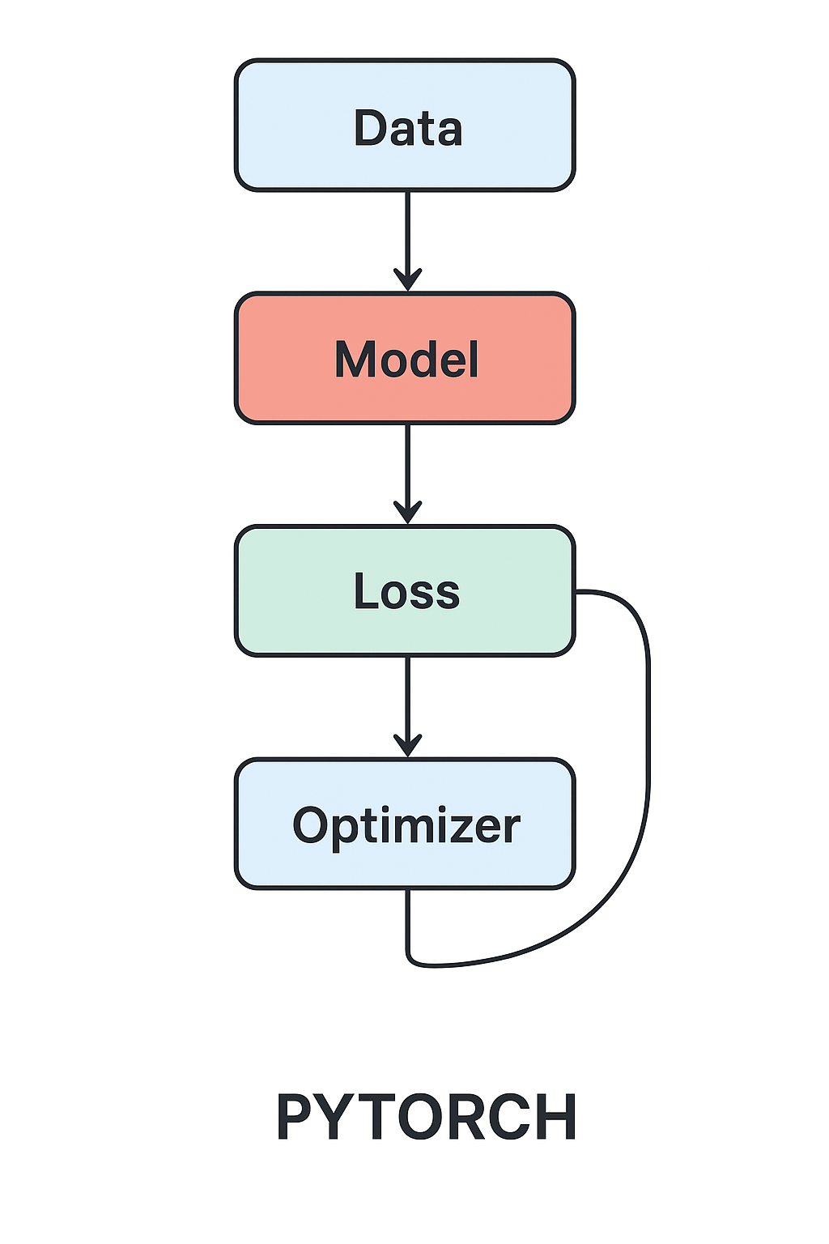
PyTorch = NumPy + GPU + Autograd + Neural Nets → a powerful framework for AI.

Slide 9
e.g:Classify handwritten digits from the MNIST dataset
import torch.nn as nnimport torch.nn.functional as F
class SimpleNN(nn.Module):
def __init__(self):
super().__init__()
self.flatten = nn.Flatten()
self.fc1 = nn.Linear(28 * 28, 128)
self.fc2 = nn.Linear(128, 64)
self.fc3 = nn.Linear(64, 10)
def forward(self, x):
x = self.flatten(x)
x = F.relu(self.fc1(x))
x = F.relu(self.fc2(x))
x = self.fc3(x)
return x

Slide 10
`model`, `train_loader`, `criterion`, and `optimizer`
import torch.optim as optim
model = SimpleNN()
criterion = nn.CrossEntropyLoss()
optimizer = optim.SGD(model.parameters(), lr=0.01)
for epoch in range(5):
running_loss = 0.0
for i, (inputs, labels) in enumerate(train_loader):
# Zero the parameter gradients
optimizer.zero_grad() //because PyTorch accumulate the gradients, it needs to be reset
# Forward + backward + optimize
outputs = model(inputs)
loss = criterion(outputs, labels)
loss.backward()
optimizer.step()

Slide 11
What is TensorFlow?
TensorFlow is an open-source machine learning framework developed by Google.
Like PyTorch, it’s used for:
Deep learning (CNNs, RNNs, Transformers, etc.)
General numerical computation (tensor operations).
Known for being high-performance and widely used in industry/production.

Slide 12
Core Concepts
1. Tensors
Just like PyTorch: multidimensional arrays.
They can run on CPU, GPU, or TPU (Google’s specialized chips).
import tensorflow as tf
x = tf.constant([[1, 2], [3, 4]])
print(x)
print(x.device) # Shows where it lives

Slide 13
Core Concepts
2. Computation Graphs
TensorFlow uses computation graphs under the hood.
In TF 1.x, you had to define a graph first, then run it (static graph).
In TF 2.x, it’s eager execution by default (just like PyTorch) → easier & more Pythonic.

Slide 14
Core Concepts
3. Automatic Differentiation
Handled by tf.GradientTape.
x = tf.Variable(2.0)
with tf.GradientTape() as tape:
y = x**2 + 3*x + 1
dy_dx = tape.gradient(y, x) # derivative = 2x + 3 → 7
print(dy_dx)

Slide 15
Keras
4. Neural Networks (with tf.keras)
TensorFlow has its own deep learning API called Keras (more below).
Example: a simple feedforward model
from tensorflow import keras
from tensorflow.keras import layers
model = keras.Sequential([
layers.Dense(5, activation="relu", input_shape=(10,)),
layers.Dense(1)
])

Slide 16
Backpropagation
5. Training Loop
TensorFlow lets you train either with:
High-level .fit() (easy, like scikit-learn)
Or a custom training loop with GradientTape.
model.compile(optimizer="sgd", loss="mse")
# dummy data
import numpy as np
x = np.random.randn(16, 10)
y = np.random.randn(16, 1)
model.fit(x, y, epochs=5)

Slide 17
Why TensorFlow?
Production-ready: optimized for deployment (mobile, cloud, TPUs).
Integration with Google ecosystem (e.g., TensorFlow Lite, TensorFlow Serving).
Hugely popular in industry applications.

Slide 18
What is Keras?
Keras is a high-level deep learning API.
Originally developed independently, later merged with TensorFlow.
Today: tf.keras is the official TensorFlow Keras implementation.
Keras is a user-friendly wrapper on top of TensorFlow (and originally Theano, CNTK).

Slide 19
Core Concepts
1. Sequential API
The simplest way: stack layers in order.
from tensorflow import keras
from tensorflow.keras import layers
model = keras.Sequential([
layers.Dense(64, activation="relu", input_shape=(100,)),
layers.Dense(10, activation="softmax")
])

Slide 20
Core Concepts
2. Functional API
More flexible → supports complex architectures (like multiple inputs/outputs, skip connections).
inputs = keras.Input(shape=(100,))
x = layers.Dense(64, activation="relu")(inputs)
outputs = layers.Dense(10, activation="softmax")(x)
model = keras.Model(inputs, outputs)

Slide 21
Core Concepts
3. Compile & Train
High-level interface, very simple:
model.compile(optimizer="adam", loss="categorical_crossentropy", metrics=["accuracy"])
model.fit(x_train, y_train, epochs=10, batch_size=32, validation_split=0.2)

Slide 22
Core Concepts
4. Advantages
Very easy to use (great for beginners).
Built on TensorFlow → still powerful.
Supports prototyping and large-scale training.

Slide 23
Feature / Aspect | PyTorch 🟠 | TensorFlow 🔵 | Keras 🟢
Developer | Facebook (Meta) | Google | Initially independent → now part of TensorFlow
Level | Mid-level (you build training loops, but still friendly) | Low to mid-level (raw ops, GradientTape, or Keras API) | High-level API (abstraction on top of TensorFlow)
Ease of Use | Pythonic, intuitive, dynamic | Powerful but more verbose (TF 1.x was harder; TF 2.x improved) | Easiest (very beginner-friendly, plug-and-play)
Execution Style | Dynamic computation graph (define-by-run) | Static graph (TF 1.x), Dynamic (TF 2.x) | Uses TensorFlow’s backend (so inherits TF execution)
Neural Network API | torch.nn | tf.nn / tf.keras | keras.Sequential / Functional API
Training | Manual training loops (flexible), or Trainer from PyTorch Lightning | Either GradientTape loops (flexible) or .fit() (simple) | Mostly .compile() + .fit() (high-level)
Automatic Differentiation | autograd | tf.GradientTape | Uses TensorFlow’s differentiation under the hood
Deployment | TorchServe, ONNX, limited mobile | TensorFlow Serving, TensorFlow Lite, TPU support (very strong in production) | Relies on TensorFlow deployment tools
Ecosystem | TorchVision, TorchText, TorchAudio, Hugging Face | TensorFlow Hub, TF Lite, TF Extended | Integrated with TensorFlow ecosystem
Performance | Great for research, prototyping | Optimized for production scale | A little overhead (since it’s a wrapper)
Community Use | Widely used in research & academia | Widely used in industry & production | Widely used for beginners & prototyping
Best For | Flexibility, research, debugging | Deployment, scalability, Google Cloud integration | Simplicity, rapid prototyping

Slide 24
Conclusion
PyTorch → favored in research (flexible, Pythonic).
TensorFlow → favored in production (scalable, optimized for deployment).
Keras → sits on top of TensorFlow as the easiest way to build models.

